Slide 1
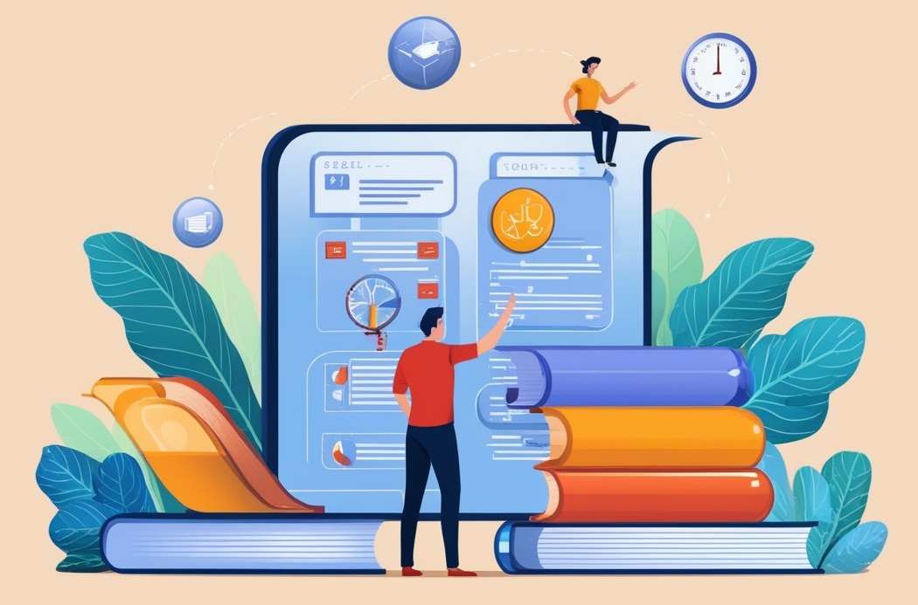
DESIGN AND ANALYSIS OF ALGORITHMS
Dr. Kashif Ayyub

Slide 2
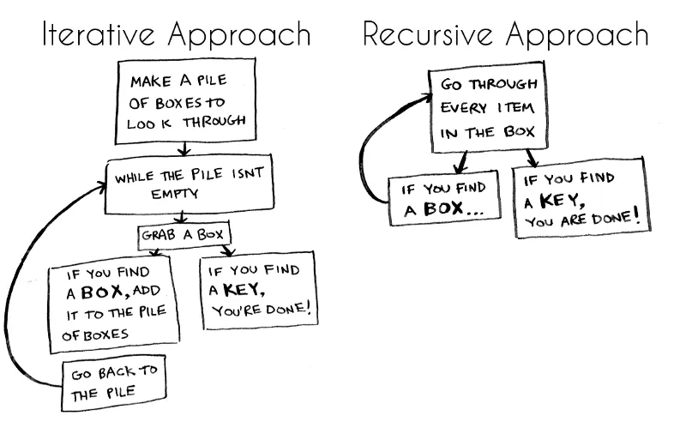

Slide 3
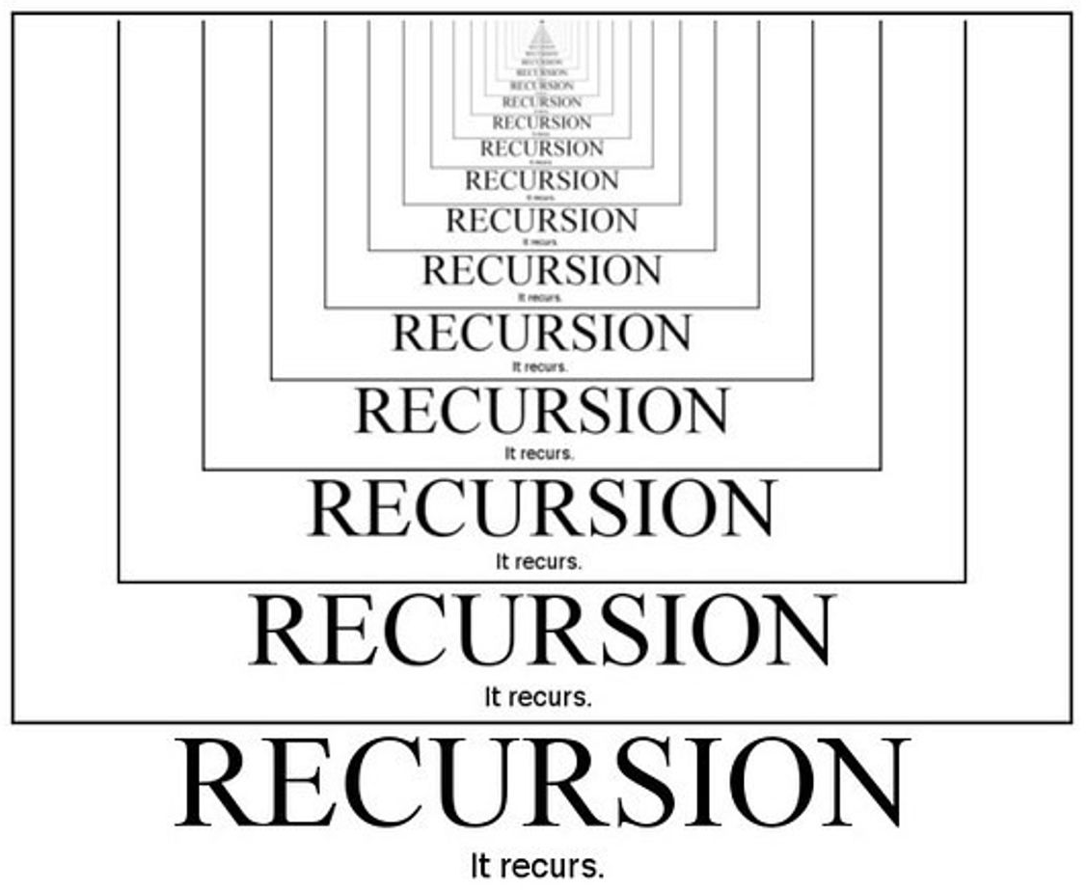
Recursion
The process in which a function calls itself directly or indirectly is called recursion and the corresponding function is called a recursive function.
Properties of Recursion:
Performing the same operations multiple times with different inputs.
In every step, we try smaller inputs to make the problem smaller.
Base condition is needed to stop the recursion otherwise infinite loop will occur.

Slide 4
Algorithm: Steps
Define a base case: Identify the simplest case for which the solution is known or trivial. This is the stopping condition for the recursion, as it prevents the function from infinitely calling itself.
Define a recursive case: Define the problem in terms of smaller subproblems. Break the problem down into smaller versions of itself and call the function recursively to solve each subproblem.
Ensure the recursion terminates: Make sure that the recursive function eventually reaches the base case and does not enter an infinite loop.
Combine the solutions: Combine the solutions of the subproblems to solve the original problem.

Slide 5
A Mathematical Interpretation
A programmer must determine the sum of first n natural numbers, there are several ways of doing that, but the simplest approach is to add the numbers starting from 1 to n.
int f(int n) {
if (n == 1)
return 1;
else
return n + f(n-1);
}
f(n) = 1 + 2 + 3 +……..+ n
Approach 1: Simply adding one by one
f(n) = 1 n=1
f(n) = n + f(n-1) n>1
Approach 2: Recursive adding

Slide 6
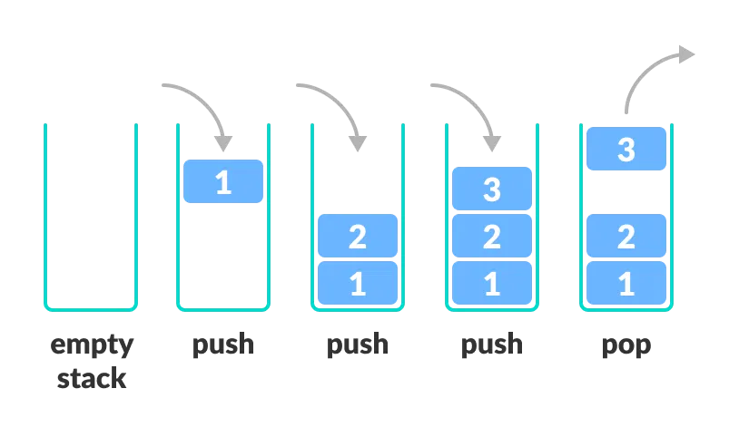
How are recursive functions stored in memory?
Recursion uses more memory, because the recursive function adds to the stack with each recursive call, and keeps the values there until the call is finished.
The recursive function uses LIFO (LAST IN FIRST OUT) Structure just like the stack data structure.

Slide 7
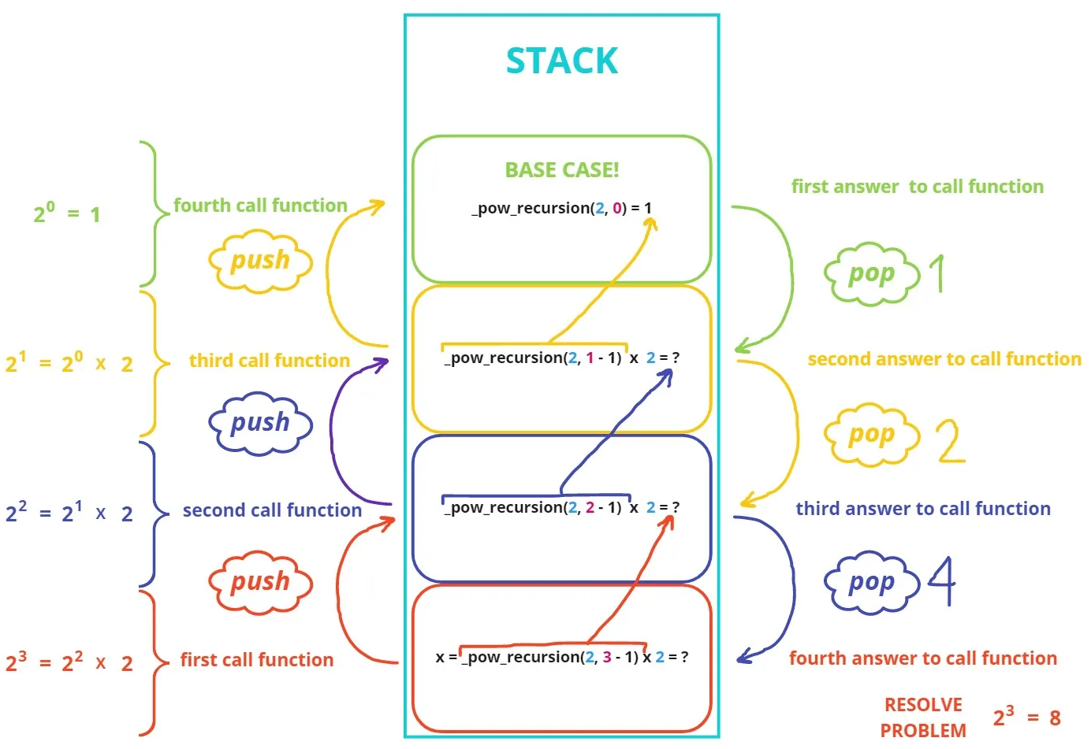
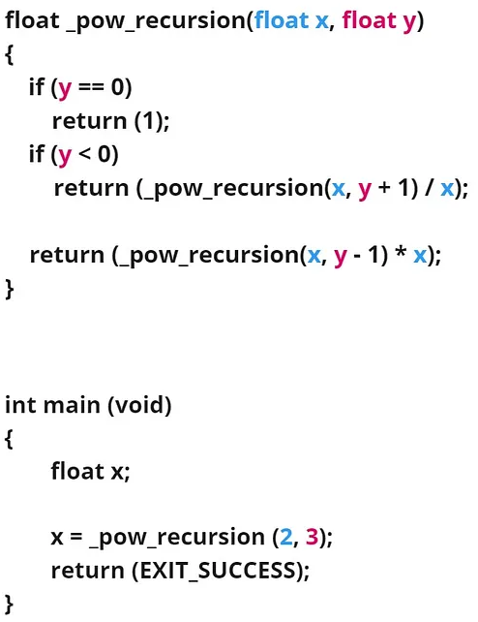
How are recursive functions stored in memory?

Slide 8
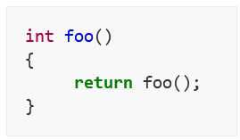
Why Stack Overflow error occurs in recursion?
If the base case is not reached or not defined, then the stack overflow problem may arise.
The most-common cause of stack overflow is excessively deep or infinite recursion, in which a function calls itself so many times that the space needed to store the variables and information associated with each call is more than can fit on the stack.

Slide 9
How to Avoid Stack Overflow Errors?
Use iterative solutions (using loops) instead of recursive solutions where possible. In some cases, iterative solutions can even be faster than recursive ones. This can help reduce the size of the call stack and avoid stack overflow errors.
Limit the recursion depth by adding a maximum recursion limit to your code. This can prevent the call stack from growing indefinitely and causing a stack overflow error.
Make sure the code stops at some point. Add proper exit conditions to your recursive functions. This ensures that the recursion will eventually stop and that the call stack will be cleared.
Increase the allowed recursion depth if necessary. This will make sure the functions can be called many times before hitting a maximum recursion depth exceeded error.

Slide 10
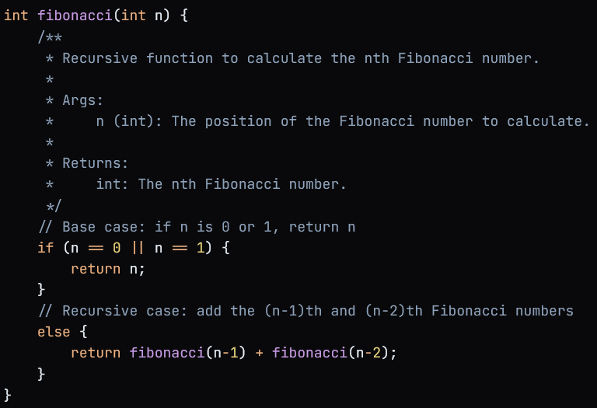
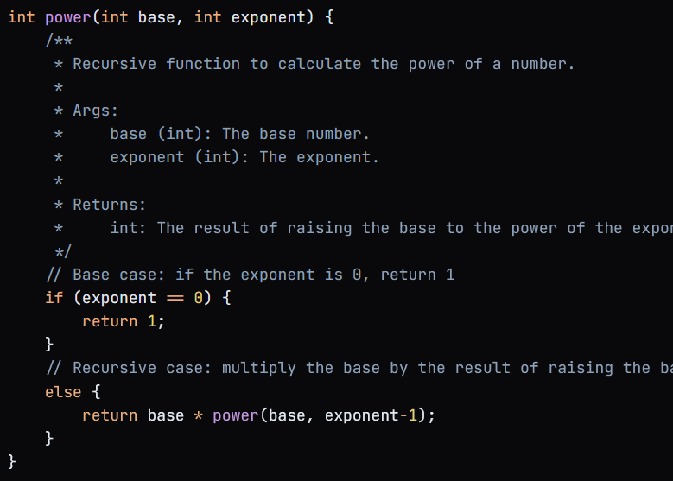
Recursive Function Examples

Slide 11
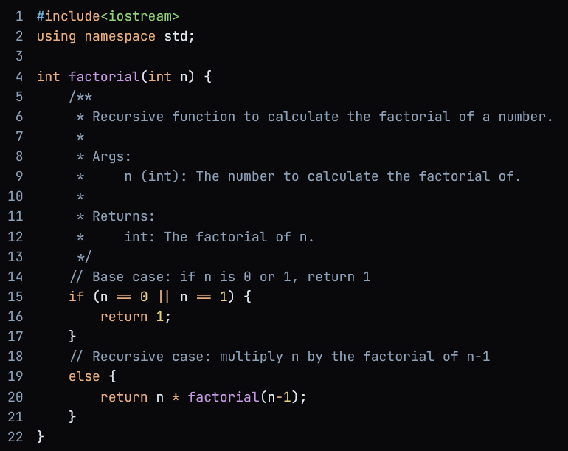
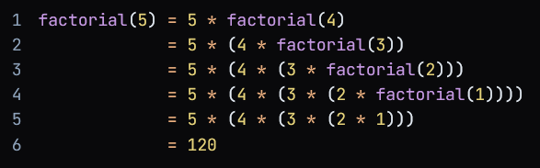
Correctness of Recursive Algorithms
Let’s take an example of factorial function.

Slide 12
Correctness of Recursive Algorithms
Is this algorithm correct for the base case?
yes, we can see that factorial(1)=1 as required
Will the algorithm terminate?
yes, at each recursive call, we reduce n by one, therefore we will eventually reach the base case.
Induction step:
Induction hypothesis: assume that the algorithm is correct for some value n=k>1, that is factorial(k) does return k!
Does the algorithm work for n=(k+1)?

Slide 13
Correctness of Recursive Algorithms
If n=k+1>1 then the algorithm will return
(k+1)*factorial(k) // Line 20
From our induction hypothesis, we assumed factorial(k)=k!, so this means that the algorithm will return (k+1)*k!=(k+1)!
Therefore, by induction, factorial(n) returns n! for all n>=1

